Slide 1
Citizen science

Slide 2
What is citizen science?
Citizen science covers various ways in which volunteers participate in science
Main characteristics:
Citizens are actively involved in research, in partnership or collaboration with scientists or professionals
Genuine scientific outcome, such as new knowledge, conservation action or policy change

Slide 3
Purpose
Contribute to the generation of new knowledge or understanding
Monitor the state of the environment
Raise awareness and inform the general public
Encourage activities with schools, volunteers, public bodies, NGOs
Engage society and stakeholders for a policy change

Slide 4
Level of involvement
Crowdsourcing: collecting data or participation in distributed computing
Distributed intelligence: classifying, interpreting and analysing data
Participatory science: participation in problem definition and designing of research; co-production of knowledge

Slide 5



Environmental citizen science
Fields of application
Air, water and soil quality
Weather and climate
Biodiversity, invasive species
Plants, birds
Odour pollution
Marine litter
Mapping

Slide 6




Citizen science portals
Zooniverse
  https://www.zooniverse.org
Scistarter
  https://scistarter.org
EU-citizen.science
  https://eu-citizen.science
Globe Observer
  https://observer.globe.gov

Slide 7
Is training required?
Basic requirement: common knowledge
Instruction is needed when we learn about a new process or install an application or equipment
  Use of specific technology or apps, laboratory kits etc.
  Installation of equipment for measuring air/noise pollution
Training is needed when data collection involves several steps or requires specific skills
Classification of identification is necessary when we make observations
  Recognizing birds – field books but also training and experience
  Marine litter - identification by material type and size
Instruction
Skills
Data collection

Slide 8
Methods
Observation: identifying, counting, weighing, measuring, etc.
Description and reporting
Photography
Geographical positioning
Collecting samples

Slide 9
Reporting
How does your data reach the scientific community?
Applications for mobile devices and internet platforms
Record
Process & analyse
Share data
Use information

Slide 10
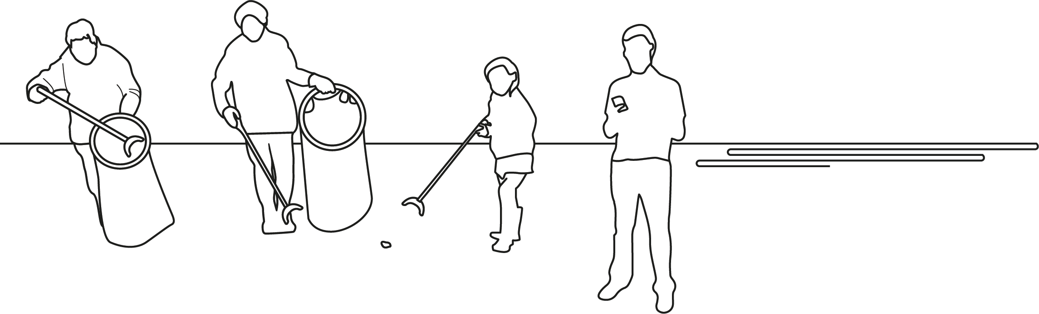
Marine LitterWatch
A citizen science system
What is it?
Mobile application by the European Environment Agency
2 million
items collected
over 3000
beach clean-up events

Slide 11
How does it work?
Install the app
Register or join community
Choose a beach
Create event: monitoring or clean-up
Implement your event and do the survey on paper or directly in your mobile device
Report

Slide 12
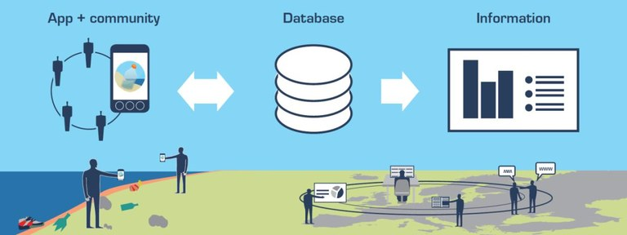
From registration to information

Slide 13
Extracting data
Check data for your community
Check data for a certain period
Download data for a certain geographical area and period
Observe short-term or long-term results
Prepare your own report or analysis

Slide 14
Citizen science results reliability
How reliable is citizen science compared to professional research?
Quality: When well prepared and implemented, results are on a scientific level
Scale: enough volunteer observers can make a valuable contribution to science and to the understanding of the processes and changes in the environment

Slide 15
Joint Operational Programme Black Sea Basin 2014–2020
The publication is edited by the Black Sea NGO Network
Varna, October 2020
Joint Operational Programme Black Sea Basin 2014–2020 is co-financed by the European Union through the European Neighbourhood Instrument and by the participating countries: Armenia, Bulgaria, Georgia, Greece, Republic of Moldova, Romania, Turkey and Ukraine
This publication has been produced with the financial assistance of the European Union. The contents of this publication are the sole responsibility of the Black Sea NGO Network and can in no way be taken to reflect the views of the European Union

